Slide 1

Read dat
User network analyses
Prajwal Kuchangi
Eric Gu
Kivi Zuo
Prarthana Neotia
Social Network Analytics: Project Proposal
November 28th, 2018

Slide 2
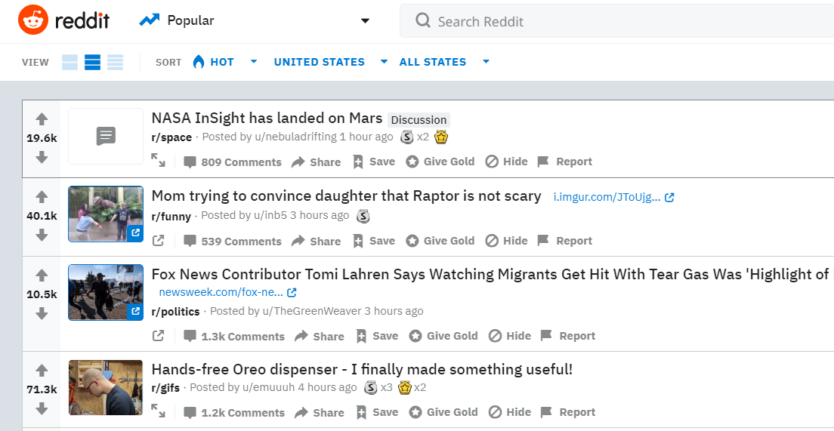
Reddit is a social media website built on anonymity.
How It All Works
Users post to communities, also known as subreddits.
Other users vote and comment on those posts.
Based on those votes, the best posts rise to the top. The anonymity helps enforce a true democracy
The users that run each subreddit define the rules that enforce in subreddits.

Slide 3
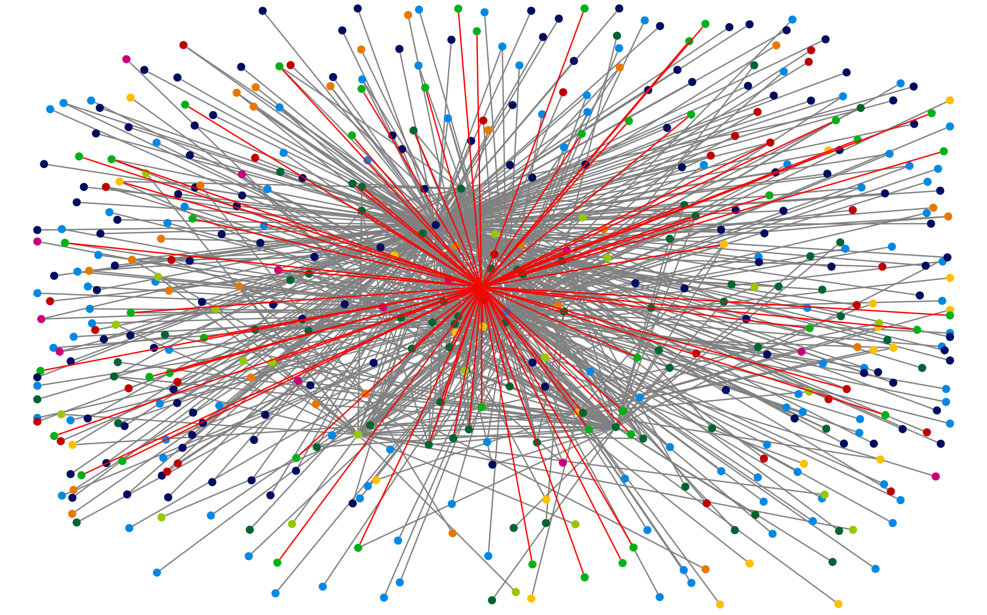
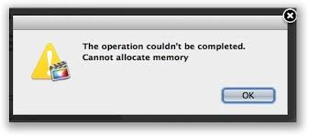
Aim : To find insights
Challenge : Huge dataset !!

Slide 4
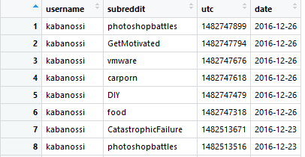
Overview of data used.
The dataset links Reddit users to the subreddits they engage with.
Each row in the data represents a user, identified by their user ID,
commenting on a uniquely identified subreddit.
The data is time-stamped in UTC.
HUGE dataset: 14 million user-subreddit relations
There are two networks we can build from the dataset:
Reddit User Network: undirected edgelist between users who engage in the same subreddits
User-subreddit Affiliation Network: directed edgelist between users and subreddits
Notes:
describe the data you are working with

Slide 5
Data Preparation and Exploration *
Generic data preparation for both networks:
Timestamps:
converted using ‘Anytime’ package in R
Decay: calculated using a 3-month cut-off
Subsetting: based on time periods
Specialized data preparation for user and subreddit networks:
Reddit User Network
Edge Weights: assigned by common threads /
total subreddits of two users
Edgelist: between users by subreddits and timestamps,
remove duplicates
User-subreddit Affiliation
Network
Edge Weights: 1 if a relationship exists
Edgeslist: between users and subreddits by timestamps, keep duplicates
* All data is subset to December 2016, unless specified otherwise
Notes:
Describe data preparation process

Slide 6
The insights map - intended goals.
Understanding the Network
Frequency of interaction
Diversity of interaction
User Activity
Popularity of subreddits
Users remain in same clusters
OR
branch out
Classify Users into active / inactive
Classify subreddits into subgroups (hot / not)
Classify users as
Generalist / Specialist
Deployment
Recommendation system
Prediction
Notes:
outline the question (issues?) you are interested in

Slide 7
User Activeness
To observe distribution of activity across user base
To classify users into different groups based on activity
To graphically inspect whether user activity depends on volume of subscriptions
Notes:
Show, for example, what were the hottest topics in a month in 2016: election, for example
Pick 5 topic examples (key word found in threads - monitor activity for those)
Focus: bitcoin (founded in 2009), soccer (fifa in 10,14,18), election (2016). This is only to narrow the focus for the presentation. Can broaden it for the actual project, if we wish to.

Slide 8
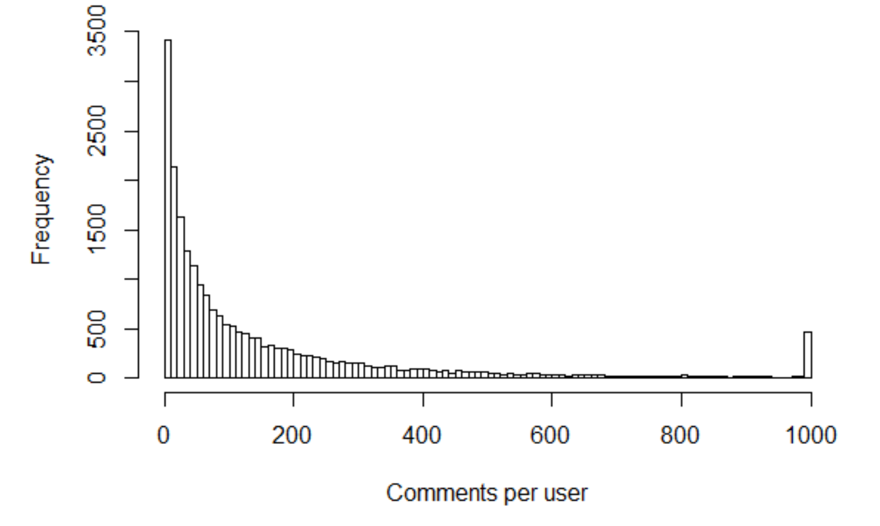
User Activeness : Distribution and Classification
The median reddit user comments 70 times per month
The activity of users is an exponentially decaying graph. Most users make less than 200 comments per month
Based on the percentile distribution, we can classify users into groups
Percentile distribution of activity per user
10% | 20% | 30% | 40% | 50% | 60% | 70% | 80% | 90%
6 | 15 | 28 | 45 | 70 | 107 | 160 | 246 | 430
Inactive | Less active |  | Active |  | Very active

Slide 9
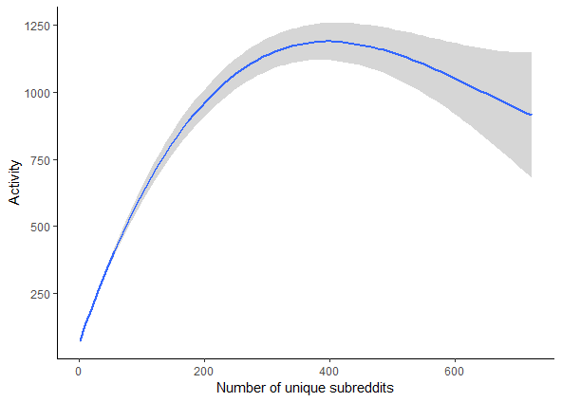
User Activeness : Dependency on volume of subscriptions
Higher the degree centrality, higher the activity. Active users tend to be subscribed to multiple subreddit threads
But there also seems to be a breaking point. Beyond a certain number of subscriptions, user activity decreases. This may be due to noise on the user’s feed.

Slide 10
Topics’ Popularity
To find the general pattern of topics if they tend to be discussed through December 2016 (all through, or sporadically)
What are the most popular topics: larger commenting population or been trendy over time
Which topics have been on Reddits for the longest time
To look at the standard deviation of popular topics over time
Notes:
Show, for example, what were the hottest topics in a month in 2016: election, for example
Pick 5 topic examples (key word found in threads - monitor activity for those)
Focus: bitcoin (founded in 2009), soccer (fifa in 10,14,18), election (2016). This is only to narrow the focus for the presentation. Can broaden it for the actual project, if we wish to.

Slide 11
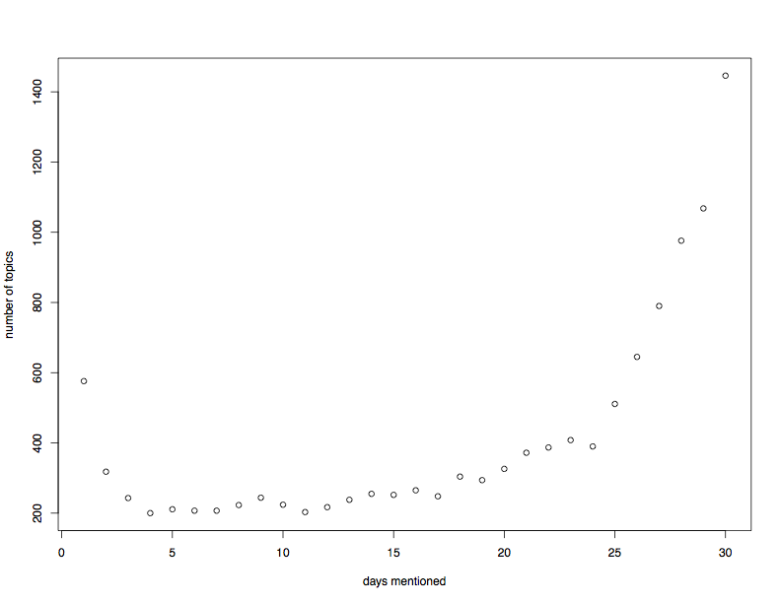
Topics’ Popularity
To find the general pattern of topics if they tend to be discussed over time or temporarily
Takeaways:
Fewer topics are mentioned for 25 days or less in December 2016
Larger numbers of topics (600 - 1400) are mentioned almost everyday in December 2016
Notes:
The above is only for December 2016.
The outliers (about 6000 topics) that were only mentioned for one day in December 2016 were removed

Slide 12
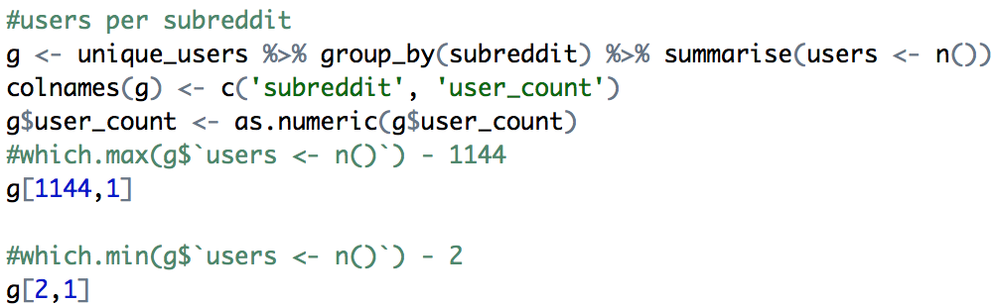
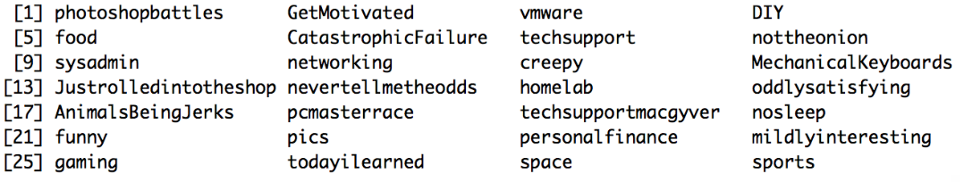
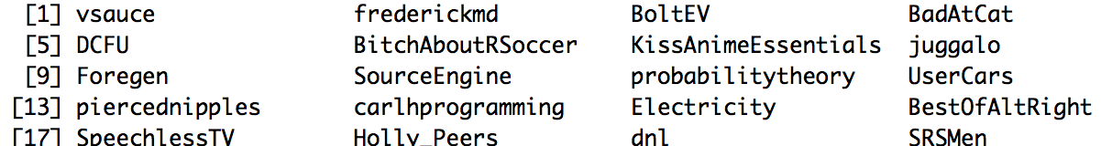
Topics’ Popularity
Through some manipulation..
Most frequently mentioned in December 2016:
Least frequently mentioned in December 2016:
We see that the subreddit with:
The most users is: AskReddit - 9637 users
The fewest users is: 1000degreeknife - 1 user

Slide 13
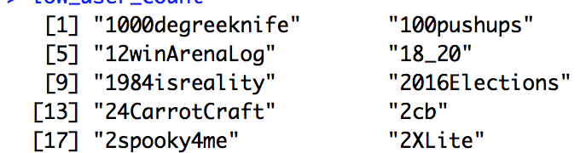
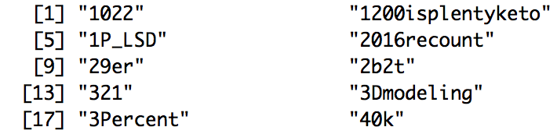
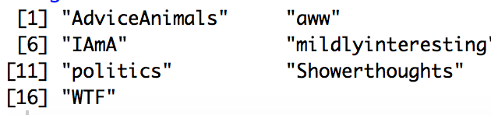
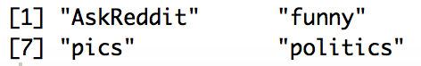
Topics’ Popularity
Least popular (user_count < 2):
Somewhat popular (user_count > 2 & user_count < 10):
Popular (user_count > 2000 & user_count < 5000)
Most popular (user_count > 5000)
Notes:
3. Which topics have been on Reddits for the longest time - cant answer without using data through the years
4. To look at the standard deviation of topics over time - standard deviation of frequency ? deviation over the months in a year?

Slide 14
Diversity
A user’s diversity will be assessed from two perspectives:
In the user network, the centrality measures will be used to assess the node’s connectedness and influence
In the user-subreddit affiliation network, the number of different subreddits will be used to assess if a user explores to more subreddits over time
Using the criterias above, users are classified into generalists and specialists
Further analysis:
If users tend to remain in the same clusters: using the user network to compute jaccard distance and plot
Notes:
discuss first results and foreshadow intended findings of the analysis (not necessary to have complete analysis at this point)

Slide 15
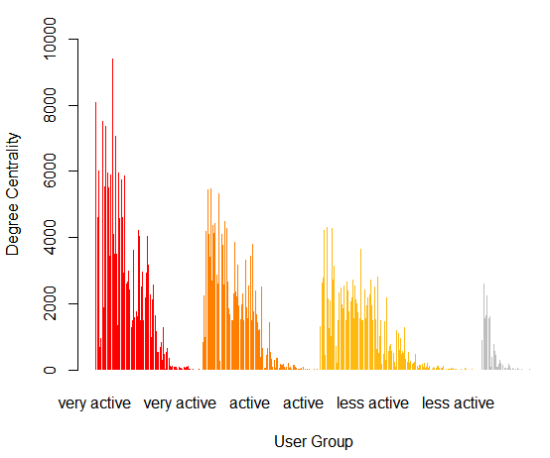
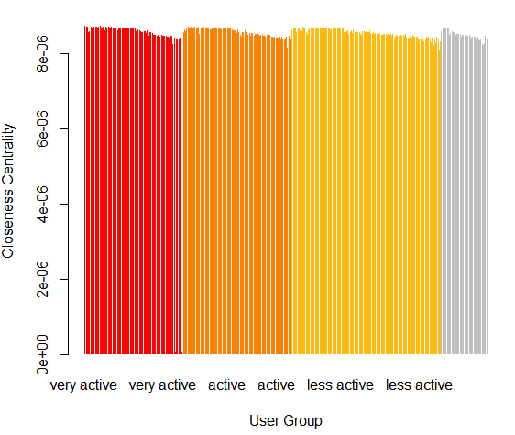
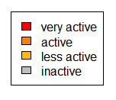
Centrality - User Network in 2016
Below is a distribution of user groups vs their degree centrality measures
Below is a distribution of user groups vs their closeness centrality measures
Notes:
In order to show an overview of the user network, the dataset is subsetted to December 2016 for subreddits with more than 50 users and less than 300 users:

Slide 16
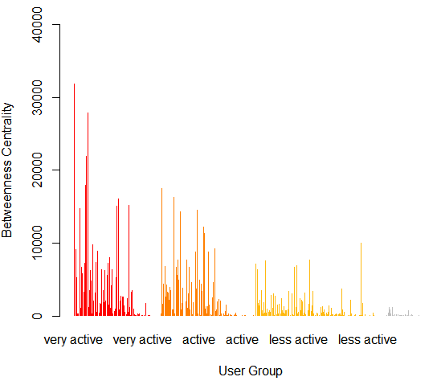
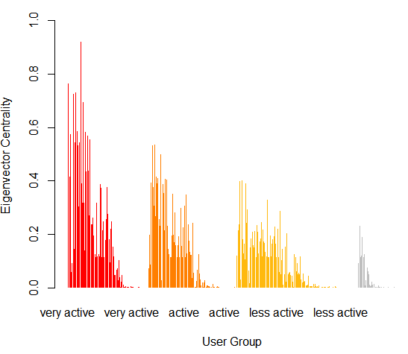
Centrality - User Network in 2016
Below is a distribution of user groups vs their betweenness centrality measures
Below is a distribution of user groups vs their Eigenvector centrality measures

Slide 17
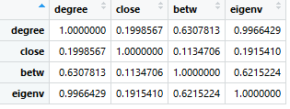
Overview of intended diversity analysis.
Insights
Highlights:
Centrality: degree
Low degree centrality implies:
outliers, comment on unpopular subreddits
Correlations in centrality measures observed.
Centrality: closeness
High closeness or reachability implies:
connect to active / high degree users, broad interest in multiple subreddits
Centrality: betweenness
High betweenness or brokerage implies:
cross-domain knowledge, connect subreddits with low user overlap
Strong Triadic Closure Define strong as larger than the mean weight
Centrality: Eigenvector
The sum of the centrality values of the nodes that it is connected to
Notes:
Clustering: *animation of clustering over time to be included
provide some insight into your analysis approach
Notes:
STC is a network level measure that helps identify whether or not the network abides by its stipulations.
Degree centrality will imply the # of neighbors a user has or how centralized / dispersed they are. This is a network level measure.
Closeness centrality talks about user reliance on the node to reach different parts of the network, the reachability of a user
Betweenness centrality talks about the ability to collect diverse information and bridge disconnected groups

Slide 18
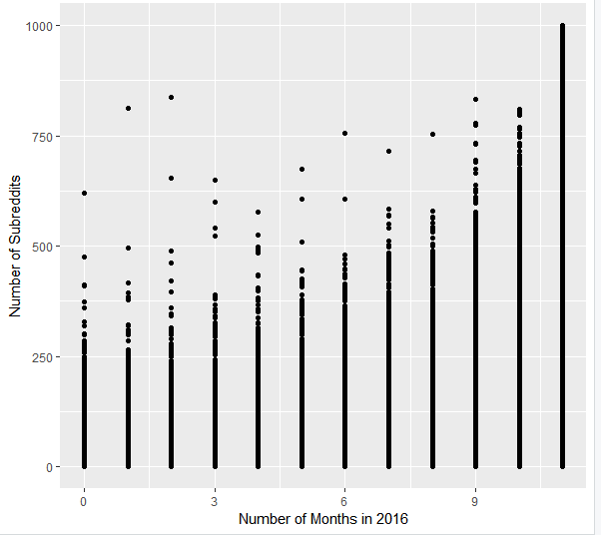
User-Subreddits Affiliation Network
In order to show an overview of the user network, the dataset is subset to the year of 2016
Correlation: if users tend to branch out to new subreddits over time

Slide 19
Prediction - Regression Models
Whether being in the core of the network helps users to branch out their interest or not:
Number of subreddits ~ coreness + account age of the user + activeness + Jaccard coordinate 1 + coordinate 2
Whether users have higher centrality measures are more active:
Activeness ~ centrality measures + account age of the user
To predict the popularity level of a given topic
Popularity Level ~ user_count + age of topic + variance of user_count + activeness + centrality measures
Notes:
SIENA

Slide 20

Recommender System
We want to ameliorate user inactivity by helping them finding communities they might be interested in.
Build a system to recommend communities to inactive users based on their commenting history
Notes:
discuss first results and foreshadow intended findings of the analysis (not necessary to have complete analysis at this point)

Slide 21

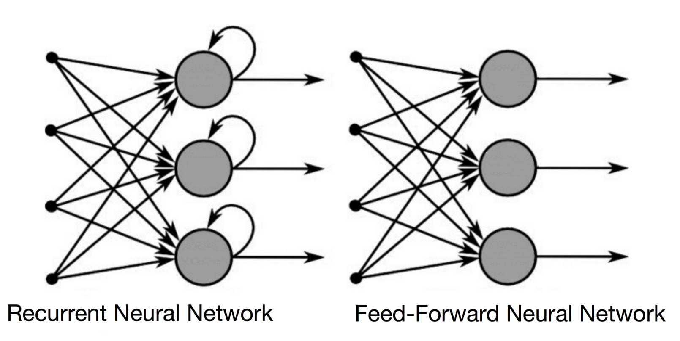

Recurrent Neural Network
Can remember information from the input they received
Internal Memory
Time series, speech, text, financial data, audio, video, etc.
Sequential Data
Notes:
discuss first results and foreshadow intended findings of the analysis (not necessary to have complete analysis at this point)

Slide 22


How It Works
Users discover new subreddits of interest as they interact with the Reddit ecosystem.
However, the new discoveries are influenced by the subreddits they have previously been interacting with.

Slide 23
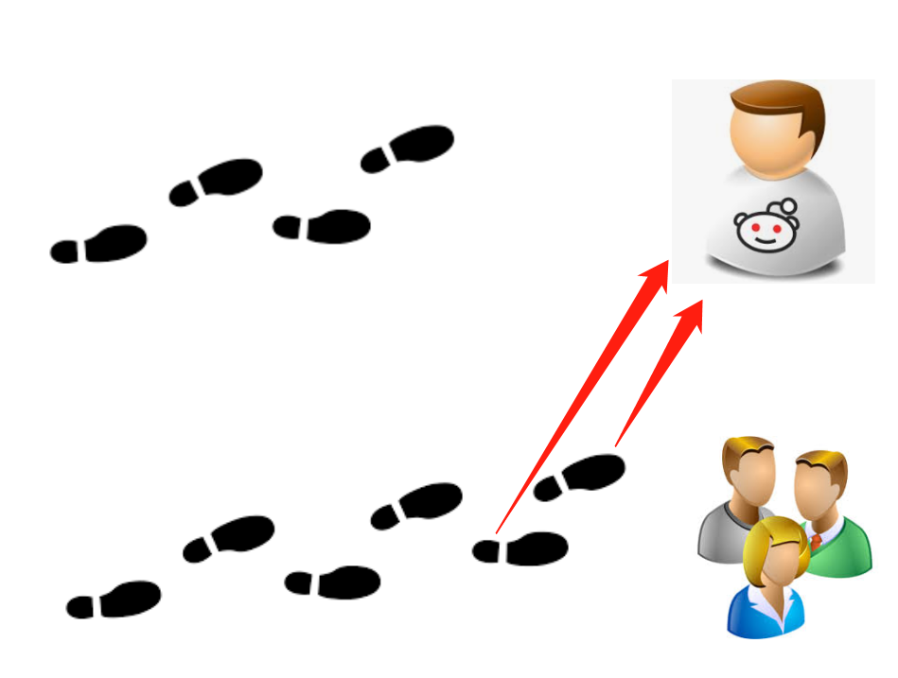
How It Works
Train a model to recognize these subreddit discoveries based on users’ historical subreddit discovery patterns.
When the model “sees” a sequence of user interactions that matches a similar sequence of interactions that other users have done, it recommends their subreddits that the current user has yet to discover.

Slide 24
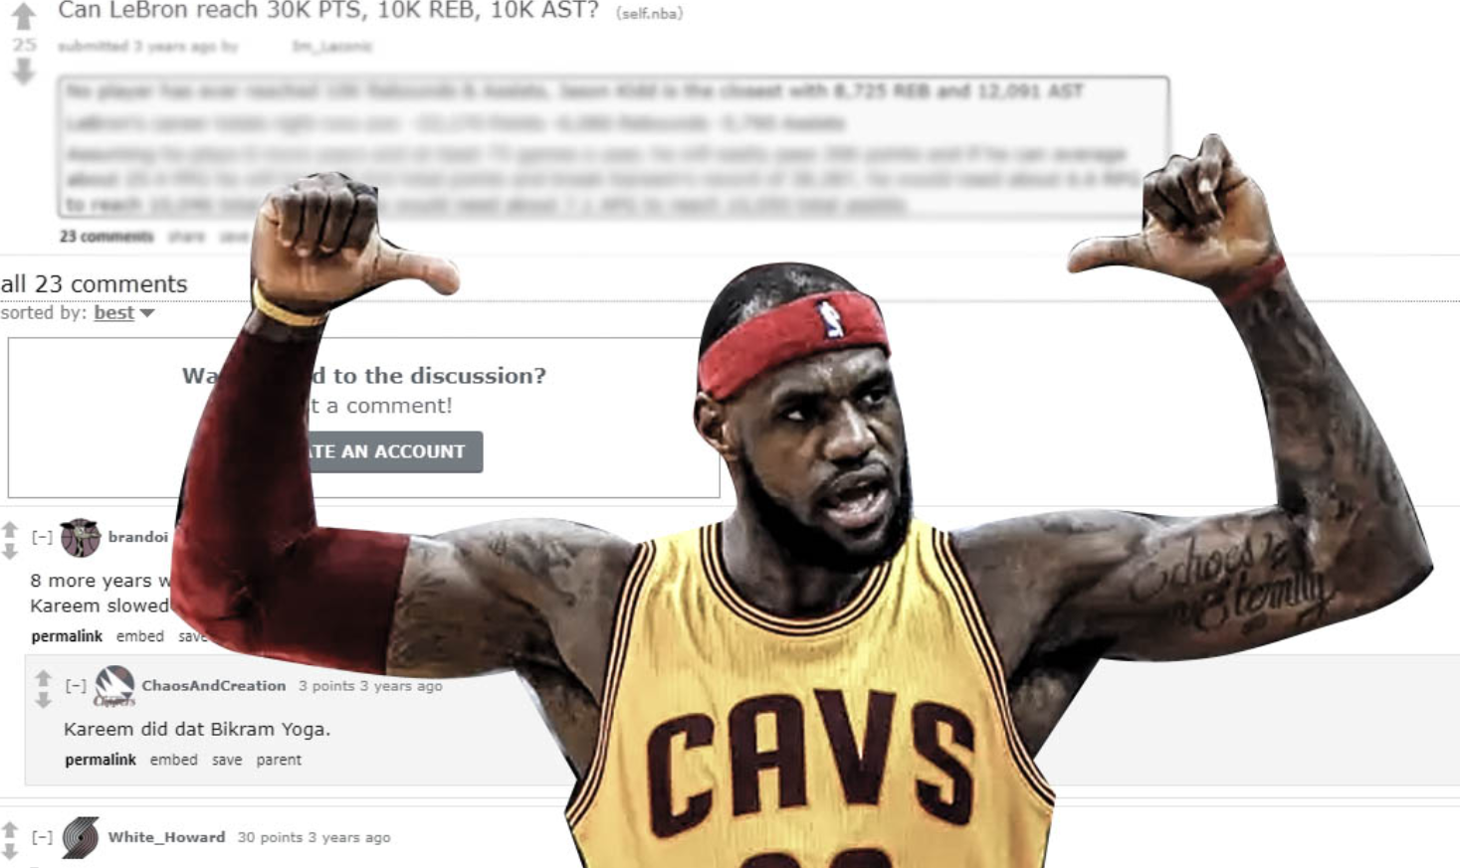


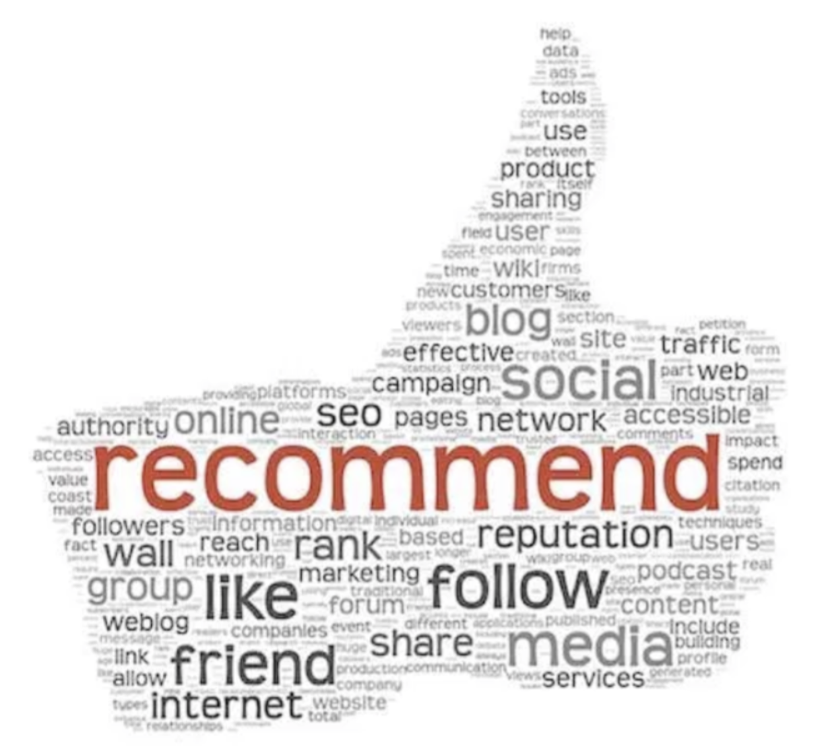

How It Works

Slide 25
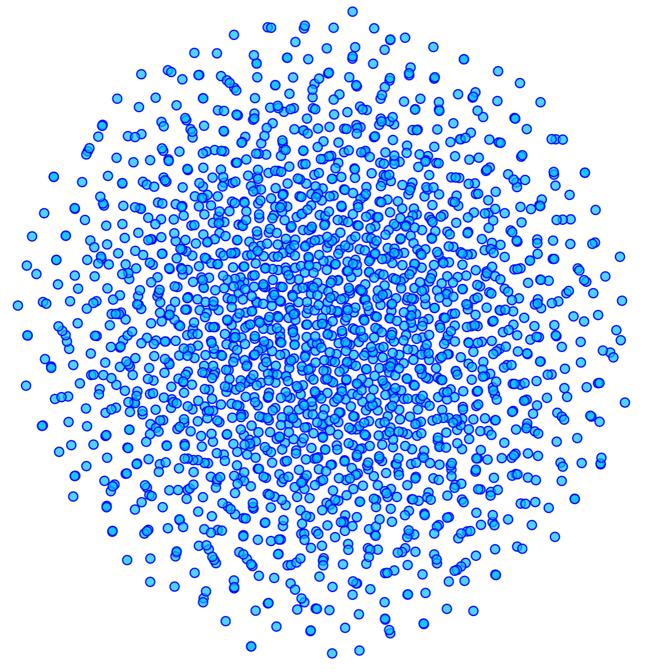
Preliminary Model Building & Visualization
Generate unique sequences of interactions from first 50,000 rows of time-stamped data
Split into training (80%) and testing (20%)
Python “TFLearn” Package
Hidden Layer -- 1 layer of LSTM (Long-short Term Memory) to extend memory over more time steps
Embedding Space

Slide 26
Thank You
Questions?

